Slide 1
Unit 2: Week 4
Grade K

Slide 2
Copyright © Savvas Learning Company LLC. All Rights Reserved.
This publication is protected by copyright, and permission should be obtained from the publisher prior to any prohibited reproduction, storage in a retrieval system, or transmission in any form or by any means, electronic, mechanical, photocopying, recording, or otherwise. For information regarding permissions, request forms, and the appropriate contacts within the Savvas Learning Company Rights Management group, please send your query to:
Savvas Learning Company LLC, 15 East Midland Avenue, Paramus, NJ 07652
or
k12learningpermissions@savvas.com
myView Literacy® is an exclusive trademark of Savvas Learning Company LLC in the U.S. and/or other countries.

Slide 3
Lesson 1

Slide 4
Page 130
Phonological Awareness
Turn to page 130 in your Student Interactive.
Notes:
Tell students that today they will learn a new sound.
Listen carefully as I say the new sound: /g/ /g/ /g/. The sound /g/ is made by placing the back of your tongue against the top of your mouth. Show students how to make the sound /g/ and have them practice it. We can hear the sound /g/ at the beginning, or onset, of some words, such as get, /g/ -et, get.
Have students turn to p. 130 in the Student Interactive. Tell them to point to the picture of the gate. Listen to the sounds as I say this word: /g/ -ate, gate.
Have students point to the picture of the goat. Listen to the sounds as I say this word: /g/ -oat, goat. Repeat both words, emphasizing the initial sound: /g/ -ate, /g/ -oat. The words gate and goat have the onset /g/. Have students blend the onset and rime of each picture word in the first column.
Name each picture on p. 130 with students. Have them complete the page.

Slide 5
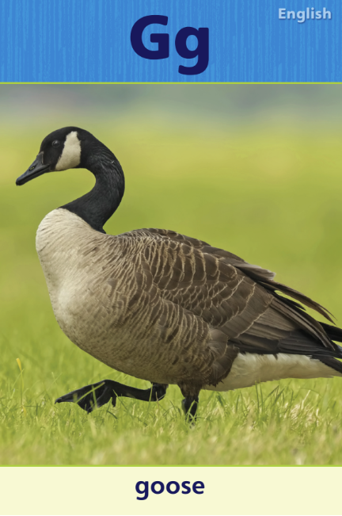
Phonics
pig gill
gum pill
hog get
fish go
big
goat
Notes:
Hold up Alphabet Card Gg and point to the picture of the goose. Let’s say the sound at the beginning of the word goose: /g/. The sound /g/ is spelled with the letter g. Point to the letters Gg on the Alphabet Card. Click path -> Table of Contents -> Unit 2 Week 4 Informational Text -> Lesson 1
Write the word goat on the board. Listen carefully to the following word: /g/ -oat. Do you hear the sound /g/ in this word? What letter spells the sound /g/? (g)
Tell students that you will read some words aloud. Tell them to listen for the sound /g/ spelled g and clap when they hear it. Display the following words, and point to the words as you read them aloud: pig, gill, gum, pill, hog, get, fish, go, big.

Slide 6
Page 131
Apply
Turn to page 131
in your Student Interactive and complete the activity.
Notes:
Have students look at p. 131 in the Student Interactive. Say: Point to the letter g and tell me the sound it spells. Now we will draw a line from each word that begins with /g/ to the letters Gg.
Direct students to the first picture. Say the word guitar, emphasizing the onset: /g/ -uitar. Does this have a /g/ sound in the onset? Yes, it does, so we draw a line from Gg to the picture of the guitar.
Review the picture words with students. Then have them complete the activity.

Slide 7
High-Frequency Words
four
five
here
Notes:
Display the high-frequency words four, five, and here.
Point to the word four and read it.
Have students point to the word four and read it.
Repeat for five and here.

Slide 8
Page 128, 129
Interact with Sources
Essential Question: What do living things need?
Weekly Question: How do different animals eat their food?
Notes:
Remind students of the Essential Question for Unit 2: What do living things need? Then introduce them to the Week 4 Question: How do different animals eat their food? Tell them that over the week they will learn about how different animals eat their food.
Have students follow along as you turn to p. 128 of the Student Interactive and point to the pictures of the anteater. Explain that the pictures show how anteaters get their food.
Then read the infographic, “How Anteaters Eat.”
Ask students to point to the pictures that show the anteater eating.
Have students tell which body part the anteater uses to eat the food shown in the pictures.
Have students tell what other body parts might help the anteater get or eat its food.
Tell students to ask questions about the infographic to clarify any information they do not understand.
Have students interact with sources by using the pictures and text on pp. 128–129 of the Student Interactive to talk about how the anteater gets its food. How is that different from the way you get your food?
Point out the Week 4 Question: How do different animals eat their food? Tell students that they just learned how anteaters eat their food. Ask students to take turns describing it to a partner, and then challenge them to talk about how other animals they are familiar with get their food.

Slide 9
Listening Comprehension
Hungry Animals
1. rats
2.
3.
4.
Notes:
Tell students that you are going to read aloud an informational text. Remind them that informational texts give facts and are about real things. These types of texts help us learn new things.
Ask students to actively listen to the text as you read it aloud. Invite them to picture in their minds the animals they hear about in the text.
Read the entire text aloud without stopping for the Think Aloud callouts.
Reread the text aloud, pausing to model Think Aloud strategies related to the genre.
Use a chart to help students identify animals they learned about in the text. Have them help you list the animals you read about in the text and the different ways those animals eat.

Slide 10
Page 143
Informational Text
Turn to page
143 in your Student Interactive.
Notes:
Tell students that today they will learn about informational texts. Informational texts give facts about a topic.
The title often tells what an informational text will be about, allowing students to gain information necessary to read the text.
Informational texts use photographs, illustrations, or maps to help explain the text. These are sometimes called graphics.
Details in the graphics tell more about the main idea.
Before reading an informational text, think about what you might learn. As you read, check to see if you are correct.
Tell students that they can use the title and pictures in an informational text to help them learn about the topic. They can also use these text features before they read to help them predict, or make a guess, about what they will learn.
Direct students to p. 143 of the Student Interactive.
I see the title “Farm Animals” and two pictures—a cow and a hen. I can guess, or predict, that this text will be about animals that you find on a farm.
Editable Anchor Chart Click Path: Table of Contents -> Reading Anchor Charts -> Unit 2 Week 4: Informational Text Editable Reading Anchor Chart: Text Features

Slide 11
Page 142
Apply
Talk about what you know about informational texts.
Notes:
Have students use strategies for using the title and graphics to learn more from an informational text.
Have students turn and talk with a partner about what they know about informational texts. Then have partners share their ideas with the class.

Slide 12
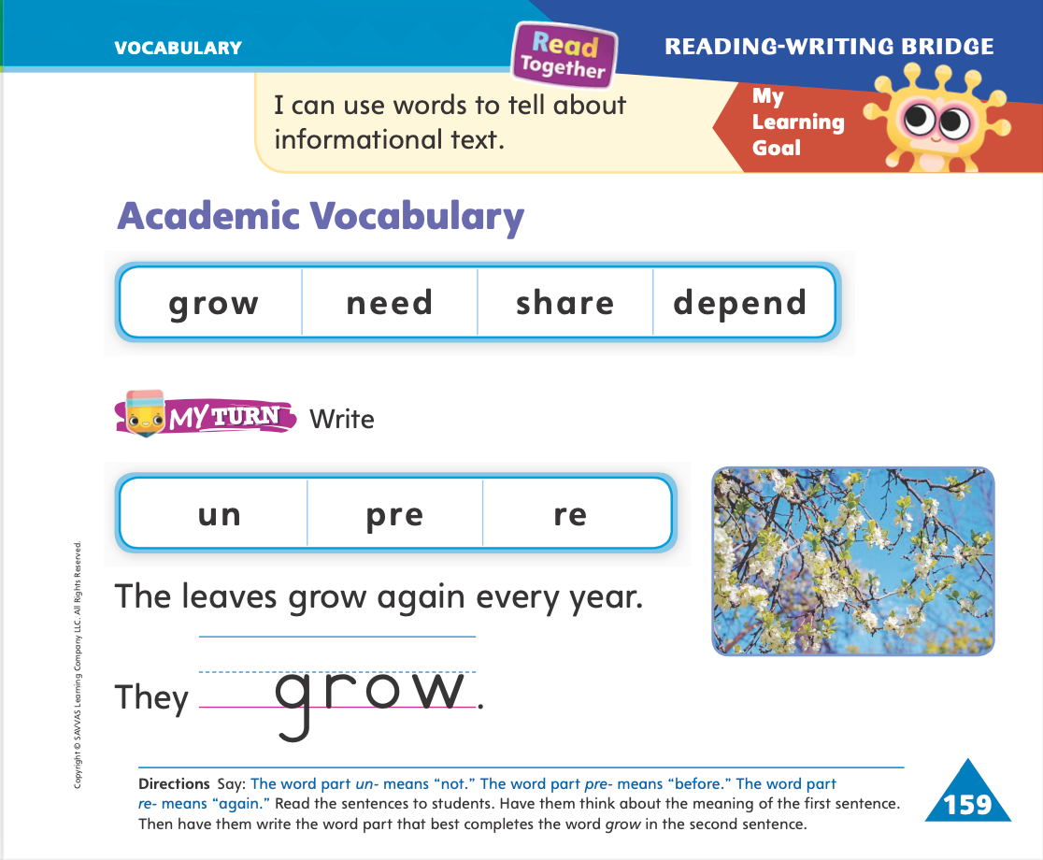
Page 159
Academic Vocabulary
Turn to page 159 in your Student Interactive and complete the activity.
Notes:
Explain to students that word parts are small parts of words that are added to a word to make a new word. Word parts can change the meaning of the base word.
Tell students that some word parts appear at the beginning of a word.
These word parts, called prefixes, change the meaning of that word.
The word part un- means "not." The word part pre- means "before." The word part re- means "again."
Write the word kind on the board and read it with students. Say: The word kind means "nice." Now write un- in front of kind. If I write the word part un- in front of the word kind, the new word is unkind. What does unkind mean? Yes, it means "not nice."
Repeat with the words happy, unhappy; cook, precook; write, rewrite; and use, reuse.
Have students complete the activity on p. 159 of the Student Interactive.

Slide 13
Handwriting
Notes:
Display an uppercase and lowercase Ee.
Model forming an uppercase E by drawing one line straight down from top to bottom. Then model drawing three lines from left to right, starting at the top.
Model forming a lowercase e by starting on the bottom half of the line, drawing a line to the right, and then curving the line up and around.
Demonstrate several times and have the students draw in the air with their fingers.
Have students use Handwriting p. 82 in the Resource Download Center to practice writing Ee. Click path: Realize -> Table of Contents -> Resource Download Center -> Handwriting Practice -> U2W4L1 Handwriting Practice

Slide 14
Page 163
Writing – List Book
Turn to page 163 in your Student Interactive.
Notes:
A singular noun names one thing. It can be turned into a plural noun, which names many things, by adding an -s or -es. Authors edit their writing to be sure they have used singular and plural nouns correctly.
Hold up a stack text and tell students that the writer of this book used nouns in his or her text. Explain that a noun is a person, animal, place, or thing. Then point out a noun in the title. Say: When a noun names only one thing, it is called a singular noun. When a noun names more than one thing, it is called a plural noun. Plural nouns usually end with the letter s. Is this noun in the title a singular noun or a plural noun?
Help students identify whether it is singular or plural. When we write our list books, we will edit them to make sure we used singular and plural nouns correctly.
Write a sentence from the stack text on the board, but change the noun to its incorrect singular or plural form.
Tell students that they will pretend to be the author and edit this sentence. Have them point out the noun and tell you what the correct word should be. Show them how to erase the incorrect word and replace it with the correct one.
Have students turn to p. 163 in the Student Interactive to continue working with singular and plural nouns.

Slide 15
Independent Writing
Edit for singular and plural nouns.
Continue writing and drawing in your list books.
Notes:
After the lesson, tell students that they should spend independent writing time reviewing their list books and editing for singular and plural nouns.
Modeled Think aloud as you look through the stack texts to identify singular and plural nouns.
Shared Write or draw a singular noun and ask the student to say, write, and draw its plural form.
Guided Prompt students to think about the singular and plural nouns they use every day.
If they demonstrate understanding, they should then continue writing and drawing in their list books using singular and plural nouns correctly.
As students write, use the conference prompts in the Teacher’s Edition or Resource Download Center to provide support. Click path: Table of Contents -> Resource Download Center -> Writing Workshop Conference Notes
Call on students to share a noun they used in their writing and identify whether it is singular or plural.

Slide 16
Language and Conventions
I smile and laugh.
Talk about actions that you are doing.
Notes:
Remind students that a verb is an action word. Act out examples, such as jump, run, and smile.
Tell students that we can tell if an action is still going on by hearing the verb.
Say the sentence I smile and laugh. Explain that the words smile and laugh show that the action is still going on. Tell them that an -ing ending also shows the present tense. Smiling and laughing show that the actions are still going on.
Ask students to tell about actions that they are doing, such as talking and reading.

Slide 17
Lesson 2

Slide 18
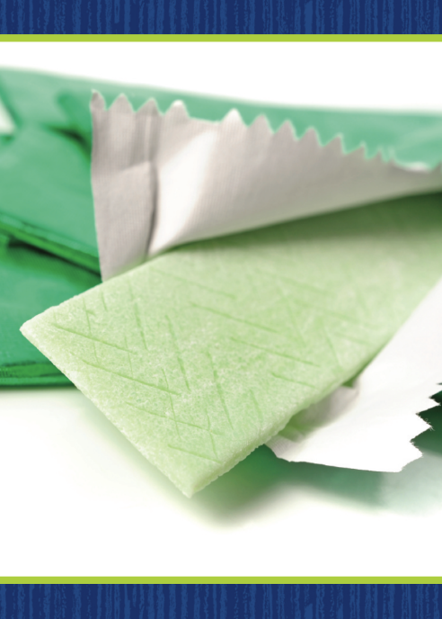
Phonics
gap
ham
goose
hill
pit
dig
bag
bed
lip
get
log
jam
gum
Notes:
Hold up the gum Picture Card. This is a picture of gum. I hear the sounds /g/ -um. I hear the sound /g/ at the beginning of gum. Say the sound /g/ with me. Click path -> Table of Contents -> Unit 2 Week 4 Informational Text -> Lesson 2
Turn the card over and show students the spelling of gum. Point to the g and say /g/. Do you hear the sound /g/? Which letter spells the sound /g/? Have students identify the letter g. Write the letters Gg on the board.
Point to the letters Gg on the board. Listen carefully to the following words: gap, ham. One word has the sound /g/. Listen carefully: /g/ /a/ /p/, gap; /h/ /a/ /m/, ham. Which word has the sound /g/ in it? Have a volunteer identify the word gap.
Which letter spells the sound /g/? Students should say g. Remind students that some words end with the sound /g/. Listen carefully to the following words: log, jam. One word has the sound /g/ at the end. Listen carefully: /l/ /o/ /g/, log; /j/ /a/ /m/, jam. Which word has the sound /g/ at the end? Have a volunteer identify the word log.
Which letter spells the sound /g/? (g) Repeat the activity using the following words: goose, hill; pit, dig; bag, bed; lip, get.

Slide 19
Page 132
Apply
Turn to page 132 in your Student Interactive and complete the activity.
Notes:
Have students complete p. 132 in the Student Interactive.

Slide 20
High-Frequency Words
four
five
here
Notes:
Tell students that high frequency words are words that they will hear and see over and over in texts.
Write and read the words four, five, and here. Have students
read each word.
spell each word, tugging lightly on their ear lobes as they say each letter.

Slide 21
Page 144
Preview Vocabulary
Notes:
Introduce the words shark, eagle, hummingbird, and turtle on p. 144 in the Student Interactive. Have students share what they already know about the animals. Have students act out each animal.

Slide 22
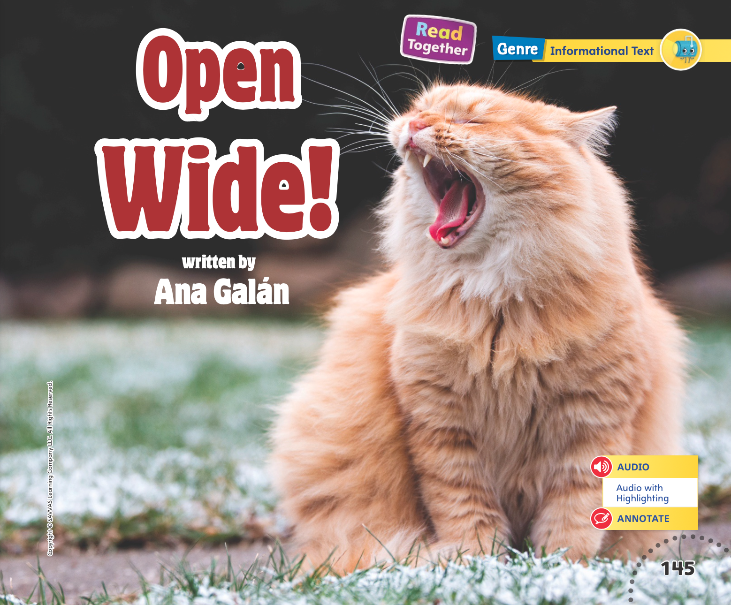
Page 145
Print Awareness
Notes:
Guide students to recognize the difference between a letter and a printed word. Tell students that words are made up of letters.
Have students look at the title on p. 144 of their Student Interactive. Ask them to find the first letter on the page (o). Tell them that the letter o is the first letter in the word Open. Work with students to count the letters in this word.

Slide 23
Page 145
First Read Strategies
Notes:
Discuss the First Read Strategies. In this first read, tell students to read for understanding and enjoyment. Explain to students that they can use the picture on the title page and the repetitive text structure to predict what the text will be about.
Have students use text features and structures to make a prediction, providing assistance as necessary. After students complete the First Read, ask: Which animals did you read about? What do those animals eat? How do they get their food?
READ Read or listen to the informational text. During the first reading, work to understand what the text is about.
LOOK Look at the pictures to help understand what the animals and their teeth and mouths look like.
ASK Generate, or ask, questions about the text to deepen understanding.
TALK Talk to a partner about the text.
Help students read the whole text independently, in pairs, or as a whole class. Use the First Read notes to help students connect with the text and to monitor comprehension.

Slide 24
Page 146,147
First Read – Open Wide!
Notes:
Read Together.
THINK ALOUD What do you notice about the pictures on p. 146? The pictures show four different animals with their mouths open. I can look at pictures to understand what each animal’s mouth and/ or teeth look like. I can do this throughout the text.

Slide 25
Page 148, 149
First Read – Open Wide!
Notes:
Read together.

Slide 26
Page 150, 151
First Read – Open Wide!
Notes:
Read Together.
THINK ALOUD I can talk with a partner about the text to better understand it. For example, I might talk to a partner about what I learned about animals from the text. I will say that I learned that a hummingbird has a very long beak. I will ask my partner to tell me something interesting he or she learned. We can talk about what we know about these animals too.

Slide 27
Page 152, 153
First Read – Open Wide!
Notes:
Read together.

Slide 28
Respond and Analyze
Talk Ask students to find a page or photo that they thought was interesting.
Illustrate the Main Idea Ask students why they thought the book was called Open Wide!
Notes:
Use these suggestions to prompt students’ initial responses to reading Open Wide!
Talk Ask students to find a page or photo that they thought was interesting. Invite them to tell what they liked about the page and what they learned from it.
Illustrate the Main Idea Ask students why they thought the book was called Open Wide! Have students draw a picture of their favorite animal mouth and tell a partner why they like it.

Slide 29
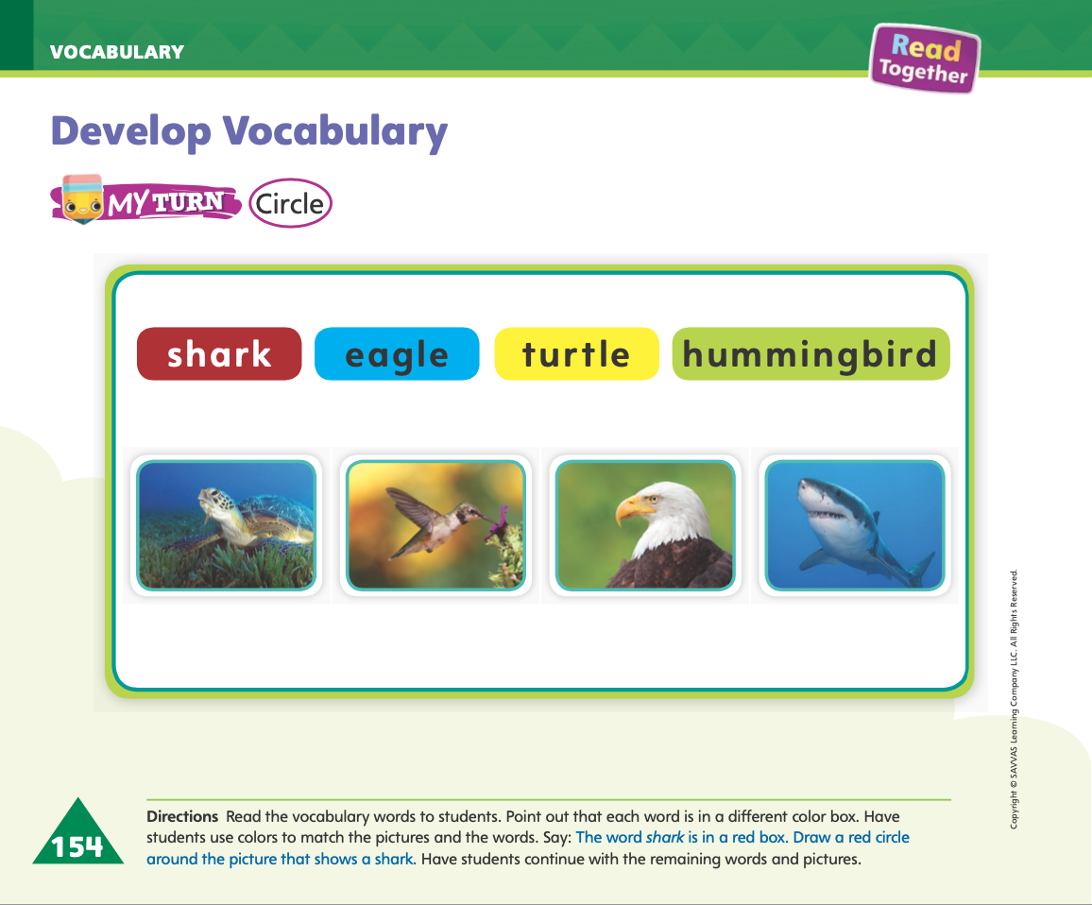
Page 154
Develop Vocabulary
Turn to page 154 in your Student Interactive and complete the activity.
Notes:
Explain to students that the author uses words that help describe what animals eat and the body parts that help them eat it. Help students identify these precise and informative words.
READ Look for words that tell more about words that are new to you or important for understanding the text.
THINK Think about why the author chose to use the word.
ASK Ask questions about the word and the context, such as Why did the author choose this word? What does this word have to do with the big idea of the text?
Help students begin working on the activity on p. 154 in the Student Interactive. Guide them through identifying the correct colors to use for each vocabulary word. The word shark is shown in red. That means I will use a red crayon to circle the picture of the shark.
Guide students through the next example if needed. Some students may need help understanding that the picture of the eagle should be circled in blue crayon.
Have students identify the picture of the hummingbird on p. 154 in the Student Interactive and circle the picture with a green crayon. Then have them repeat with a yellow crayon for the picture of the turtle.

Slide 30
Page 155
Check for Understanding
Turn to page 155 in your Student Interactive and complete the activity.
Notes:
Have students complete the Check for Understanding on p. 155 in the Student Interactive.

Slide 31
Writing – List Book
A complete sentence begins with a capital letter.
Notes:
As authors edit their writing, they make sure they used capital letters correctly. Authors follow rules when deciding which words to capitalize.
• A complete sentence begins with a capital letter.
Tell students that authors use both uppercase and lowercase letters in their writing. Another name for an uppercase letter is a capital letter.
Tell students you will go on a capital letter hunt. Using a stack book, point out capital letters that start sentences, and encourage students to help find them too. Have students name the capital letters they see. Then say: All of these words begin with capital letters. I wonder why they begin with capital letters. I see that each capitalized word is at the beginning of a sentence. Each sentence begins with a capital letter and ends with a period or other punctuation mark. When I write a sentence in my list book, I will begin the sentence with a capital letter, just like the author of this book.
Write several sentences on the board or flipchart, not capitalizing the first letter. All of these sentences are complete sentences. A complete sentence should begin with a capital letter and end with a punctuation mark. I'm going to edit these sentences for capitalization.
Have students tell you which words to capitalize, providing assistance as necessary. Model circling the letter that needs capitalizing and writing a capital letter instead.

Slide 32
Independent Writing
Let’s review your list books and edit for capitalization. Look for words that start a sentence.
Continue writing and drawing your list books.
Notes:
During independent writing time, have students demonstrate understanding of capitalization by reviewing their list books and editing for capitalization. Tell them to look for words that start a sentence.
As time allows, students should continue writing and drawing their list books.
MODELED - Do a Think Aloud to model where you would capitalize a word in a sentence.
SHARED - Point to capitalization errors in a sentence and prompt students to suggest a correction.
GUIDED - Provide explicit instruction on which words to capitalize.If some students are ready to write, they can use this time to begin writing their books.
As students write, use the conference prompts in the Teacher’s Edition or Resource Download Center to provide support. Click path: Table of Contents -> Resource Download Center -> Writing Workshop Conference Notes
Call on a few students to explain what words they changed to capital letters.

Slide 33
Page 160
Rhyming Sort
cat
bat
Turn to page 160 in your Student Interactive and complete the activity.
nice
twice
Notes:
Remind students that rhyming words have the same ending sound. Give examples of rhyming pairs, such as cat/bat and nice/twice. Restate the ending sound as you tell students each word.
Demonstrate how to match the rhyming words on p. 160 of the Student Interactive. In the first box on the top, I see a person who looks very hot. I will look on the bottom row for a word that rhymes with hot. I see a rock, a cap, and a knot. The last picture is the one I am looking for. Knot rhymes with hot. Demonstrate how to draw a line between the two pictures.
Have students complete the activity on p. 160 in the Student Interactive to identify and produce rhyming words. Provide help as needed.

Slide 34
Language and Conventions
Dan walked to the park.
kicked changed biked
Work with your partner to make a
sentence for each word.
Notes:
Remind students that a verb is an action word. Tell students that a verb can be said or written to show that the action already happened and has stopped.
Give an example of a sentence with a past tense verb, such as Dan walked to the park. Say: I know that Dan is finished walking because of the -ed at the end of the word walk. The sentence does not say Dan walks to the park. It says he walked to the park. It’s something he already did. He’s there and done!
Write several regular past-tense verbs on the board, such as kicked, changed, and biked. Have students work in pairs to come up with a sentence for each word.

Slide 35
Lesson 3

Slide 36
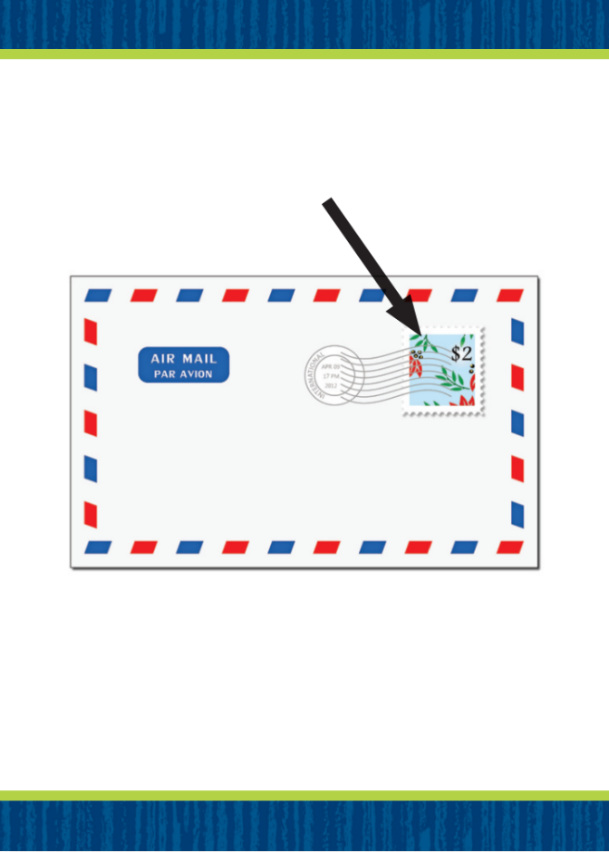
Page 133
Phonological Awareness
Notes:
Tell students that a consonant blend is two or more consonant sounds heard together at the beginning or end of a word.
Display the stamp Picture Card. This is a picture of a stamp. Listen to the two beginning sounds as I say this word: /st/ -amp. Which two blended sounds does stamp begin with? Yes, /s/ and /t/. Click path -> Table of Contents -> Unit 2 Week 4 Informational Text -> Lesson 3
Hold up your hand. This is my hand. Listen to the two ending sounds as I say this word: ha- /nd/. What blended sounds does hand end with? Students should supply the sounds /n/ and /d/.
Have students point to the picture of the stem on p. 133 in the Student Interactive. Listen to the sounds of this word: /st/ /e/ /m/. Stem has the blended sound /st/ at the beginning. Circle the pictures in the first row that have the same blended sound at the beginning. Continue with the second row for the ending blend /nd/.

Slide 37
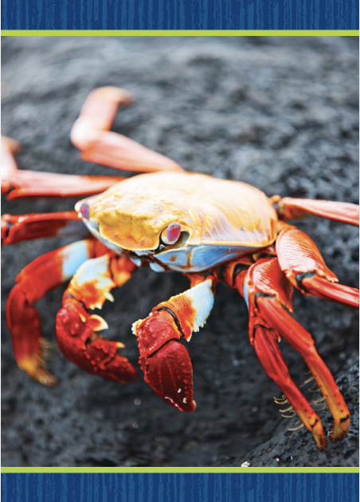
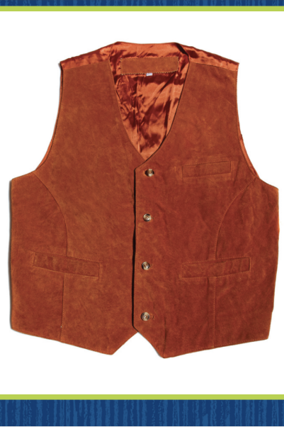
Page 134
Phonics
crab
vest
Notes:
Tell students that when two consonants are together, they can spell a blended sound. Display the crab Picture Card. Tell students that the word crab begins with a consonant blend. Write the word on the board. Listen as I decode this word: /kr/ /a/ /b/, crab. Crab has the blended sounds /kr/ at the beginning. Which letters spell the blended sounds at the beginning of crab? Students should say c and r. Repeat the routine with the vest Picture Card. Click path -> Table of Contents -> Unit 2 Week 4 Informational Text -> Lesson 3

Slide 38
Page 134
Phonics
Turn to page 134 in your Student Interactive and complete the activity.
Notes:
Have students turn to p. 134 in the Student Interactive. Let’s say the first picture word, spot, and listen to the word: /sp/ /o/ /t/. The word begins with a blended sound. Listen to the word again: /sp/ /o/ /t/. Do you hear the blended sounds at the beginning of spot? Let’s find the letters that spell the blended sounds /sp/, s and p, and trace them. Now let's draw a line from the letters to the picture.
Have students complete the activity on p. 134, providing guidance when necessary.

Slide 39
Page 135
High-Frequency Words
Turn to page 135 in your Student Interactive and complete the activity.
Notes:
Today we will practice reading the high-frequency words four, five and here.
Have students read the words at the top of p. 135 in the Student Interactive with you: four, five, here.
Have students look at the words at the top of p. 135. Say: I will read a word, and I want you to point to it. Then we will read the word together. Read four, and have students point to it.
Now let’s read the word together: four. Repeat with the other words.
Have students read the sentences on p. 135 in the Student Interactive with you. Ask them to identify the words four, five, and here in the sentences and underline the words. Then have them read the sentences with a partner.

Slide 40
Page 145
Find Text Features
Notes:
Tell students that informational texts include things that help the reader understand the topic better. Some of the most important of these text features are photographs, or illustrations, and titles. Students can
look at photographs and illustrations before reading to achieve specific purposes, such as predicting what the text will be about.
use the title to gain information about what the text is about.
pay attention to photographs and illustrations during reading to get more information than the words alone give.
use the photos to help you understand the meaning of new, challenging, or interesting words.
Readers can preview text features such as titles and photographs, or they can read the title and look at each photo as they read. Tell students that they should look at each photograph as the words are read aloud to them.
Remind students that they just read an informational text about how different animals eat. Model how to use the photos in the informational text to learn more about the topic.
On page 149, I see an eagle with its yellow beak. It uses its beak to eat. Direct students to the Close Read note on p. 149. Have them underline the words on pp. 148–149 that tell what the pictures show.
On page 150, I see a hummingbird drinking nectar from a flower. The picture helps me understand what the words are describing. Point out to students the Close Read note on p. 151. Have them underline words that tell what the pictures on pp. 150–151 show.

Slide 41
Page 148, 149
Close Read - Find Text Features
Turn to page 148, 149 in your Student Interactive.
Notes:
Have students discuss the text features you see on the pages. Point out that the pictures are text features. Then have students underline the words that tell what the pictures on pp. 148–149 show. DOK 2

Slide 42
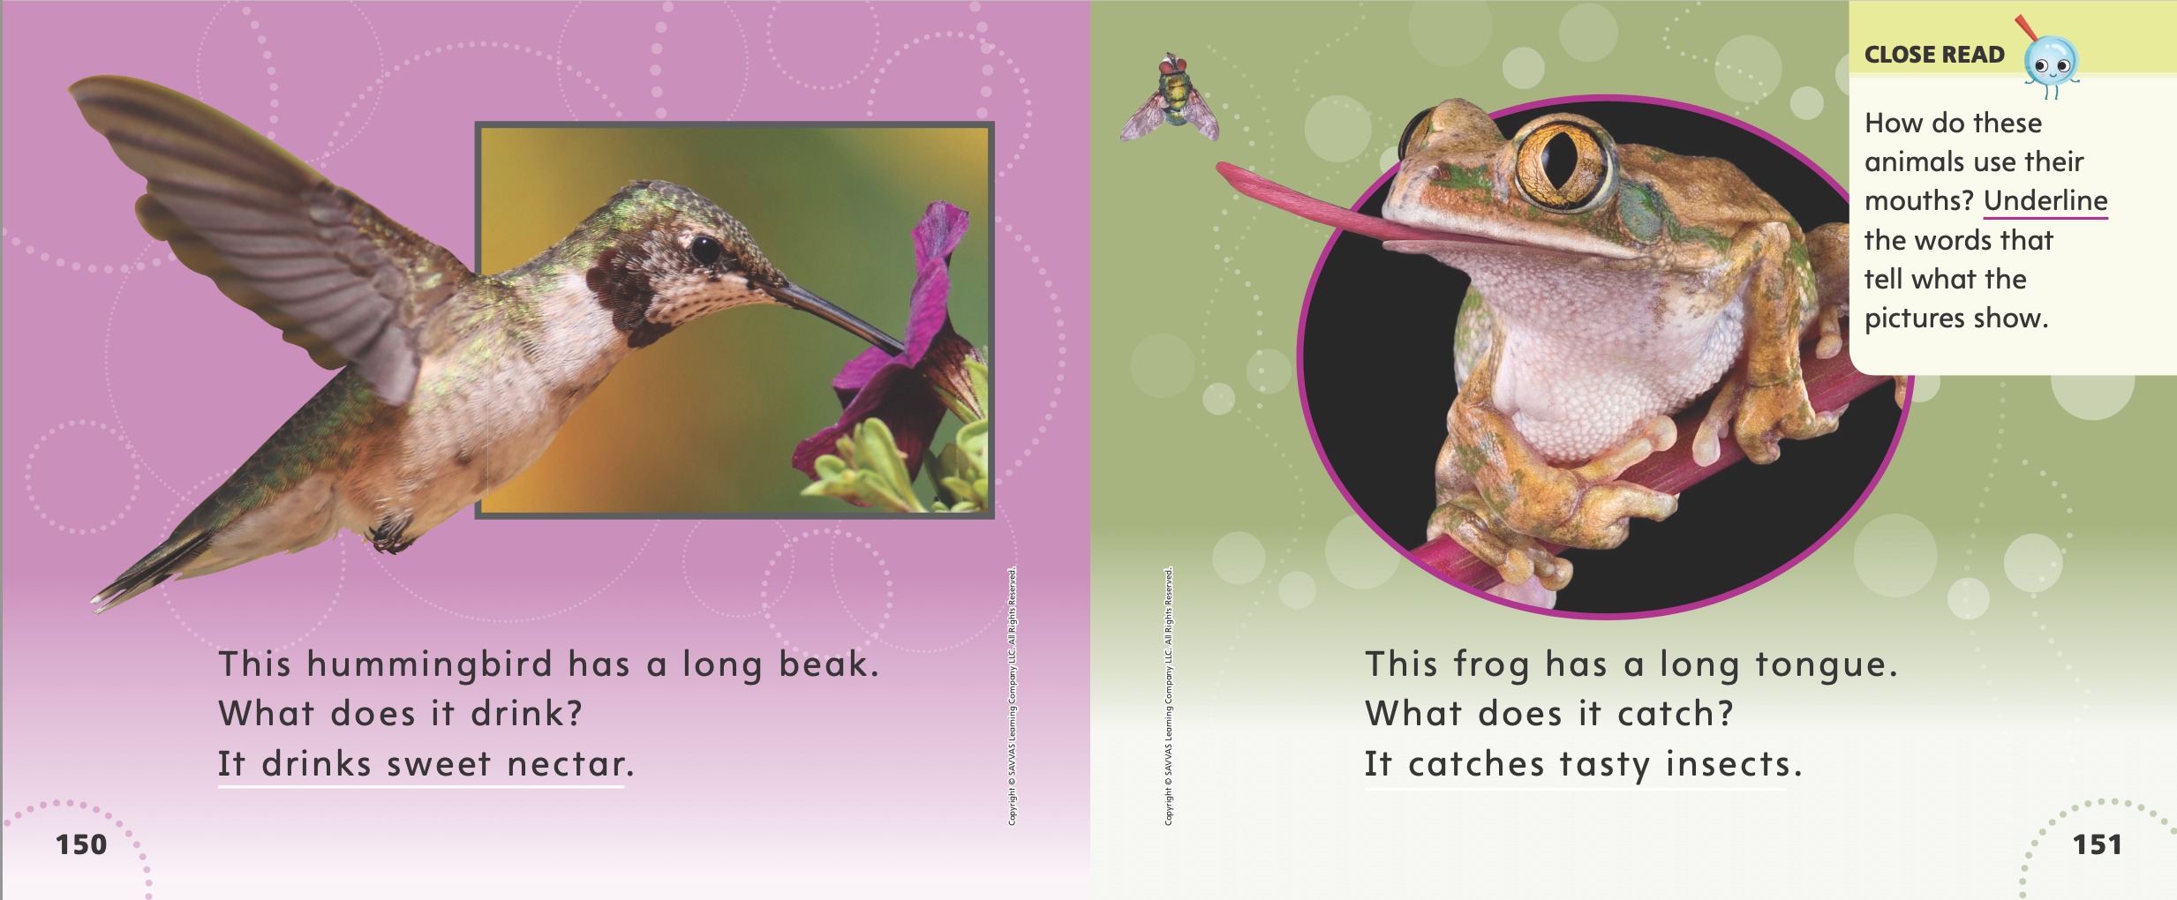
Page 150, 151
Close Read - Find Text Features
Turn to page 150, 151 in your Student Interactive.
Notes:
Have students look at the pictures on pp. 150–151. Point out that these pictures show how animals use their mouths. Then ask them to underline the words that tell what the pictures show. DOK 2

Slide 43
Page 156
Find Text Features
Turn to page 156 in your Student Interactive and complete the activity.
Notes:
Have students use the strategies for identifying and using text features such as titles and photos to understand a text.
Have students complete the MyTurn activity on p. 156 in the Student Interactive by identifying the title and drawing a picture to show details that they learned in the text.

Slide 44
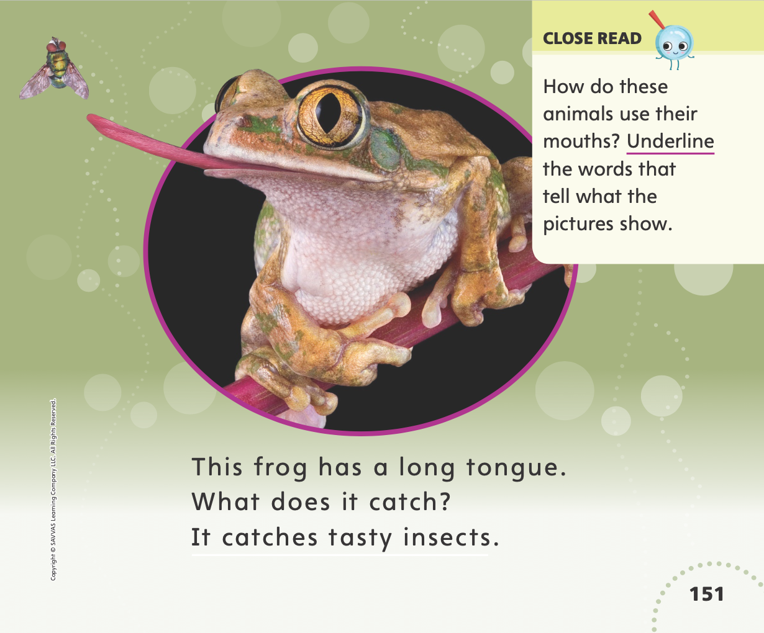
Page 151
Read Like a Writer, Write Like a Reader
Turn to page 151 in your Student Interactive.
Notes:
Explain to students that writers of informational texts use words that help readers visualize, or picture, important details about the topic:
Authors use words that describe the main topic and details.
Authors use words that help the reader visualize, or picture, the topic.
Ask students to turn to p. 151 in the Student Interactive. Reread the text for students. The author uses good words to describe the frog and how it eats. The word long tells about the frog’s tongue. There’s a good word to describe the insects the frog eats. The word is tasty. The words long and tasty give me good information about this topic. Provide additional examples of words the author uses to describe animals and how they eat.

Slide 45
Page 161
Apply
Turn to page 161 in your Student Interactive and complete the activity.
Notes:
Have students complete p. 161 of the Student Interactive. Help them find the text on hummingbirds in the shared read if necessary.

Slide 46
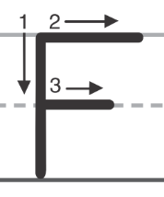
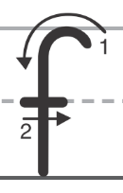
Handwriting
Notes:
Display uppercase and lowercase Ff.
Model how to write the uppercase F by making a straight line from top to bottom. Then model drawing a short line at the top from left to right and another line in the middle from left to right.
Model how to form a lowercase f by making a curved line from top to bottom with a short line across. Demonstrate several times and have students draw in the air with their fingers.
Have students use Handwriting p. 83 in the Resource Download Center to practice writing Ee. Click path: Realize -> Table of Contents -> Resource Download Center -> Handwriting Practice -> U2W4L2 Handwriting Practice

Slide 47
Page 164
Writing – List Book
Turn to page 164 in your Student Interactive and complete the activity.
Notes:
An author edits his or her work for the correct use of capitalization. Each complete sentence should begin with a capital, or uppercase, letter.
Use a stack book to show that the beginning word of each sentence is capitalized. Do a Think Aloud as you explain why the words are capitalized. This is a complete sentence because it begins with a capital letter and it ends with a period. Another sentence comes next; it begins with a capital letter too. I know that capital letters are always used at the beginning of sentences.
Tell students that good writers edit their work. They make sure all the correct words are capitalized.
Provide a simple prompt, such as on the playground or on the way to school. As a class, write a short paragraph. When the paragraph is complete, tell students that you will now edit the draft for correct capitalization. Reread the paragraph with students and have them help you decide if words have been capitalized correctly. Show them how to correct any errors in capitalization.
Have students complete p. 164 in the Student Interactive.

Slide 48
Independent Writing
Let’s look at your list books and edit for capitalization.
Continue writing your list book using correct capitalization.
Notes:
During independent writing time, have students return to books they have written this unit and edit their writing for correct capitalization.
Modeled Model looking through a stack text to find words that need capitalizing.
Shared Use the stack text to help students identify capitalized words.
Guided Prompt students to write using capital letters.
If they demonstrate understanding, students should continue writing their list book using correct capitalization.
As students write, use the conference prompts in the Teacher’s Edition or Resource Download Center to provide support. Click path: Table of Contents -> Resource Download Center -> Writing Workshop Conference Notes
Call on a few students to explain what words needed capitalization in their writing.

Slide 49
Language and Conventions
We stopped the car at the red light.
Maya shouted for her team at the baseball game.
Notes:
Read the sentence. Then have students tell you which word in the sentence is a verb. After they identify stopped as a verb, ask them if the action happened in the past, or if it is still going on.
Ask students how they know that the action happened in the past.
Model another example: In the sentence “Maya shouted for her team at the baseball game,” there is a verb. It is a word that shows an action. The word shouted shows that Maya made a loud sound to cheer her team, but she is done doing that now.
Provide additional examples as needed so that students can easily identify the action word and understand that the action took place in the past.

Slide 50
Lesson 4

Slide 51
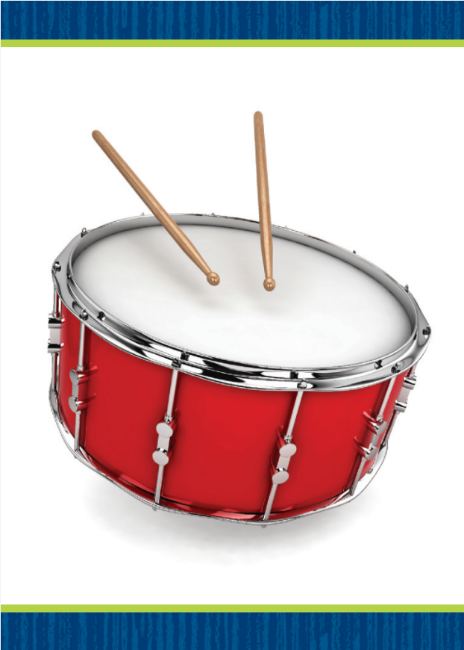
Page 136
Phonics
Turn to page 136 in your Student Interactive.
Notes:
Hold up the drum Picture Card. This is a picture of a drum. I hear two sounds at the beginning of drum. Say the two sounds with me: /dr/. Show students the spelling of the word. Point to the d and say /d/. Point to the r and say /r/. Then move your fingers quickly from d to r, and quickly say /dr/. Do you hear the two blended sounds /dr/? Which letters spell the blended sounds /dr/? Click path -> Table of Contents -> Unit 2 Week 4 Informational Text -> Lesson 4
Have students use letter-sound relationships to decode other words that begin with the blended sounds /dr/. Examples may include dragon, drop, and dress.
Write the words ramp and stop on the board. Listen carefully as I use what I know about letters and sounds to decode these words: /r/ /a/ /mp/, ramp; /st/ /o/ /p/, stop. In each word there are two blended sounds. Listen: /r/ /a/ /mp/; /st/ /o/ /p/. Which word has the blended sounds at the end? Yes, ramp. Which letters spell the blended sounds? Students should say the letters m and p. Repeat for the beginning blend in stop.
Have students complete p. 136 in the Student Interactive.

Slide 52
Page 137
Decodable Story
four
five
here
Turn to page 137 in your Student Interactive. We will read “Pig and Frog”.
Notes:
Have students turn to p. 137 in the Student Interactive. We are going to read a story today about a pig and a frog.
Point to the title of the story. The title of the story is Pig and Frog. I hear the sound /g/ in the word Frog. Which other word has the sound /g/? Students should say Pig. I hear a word with the blend /fr/. Which word is this? Students should say Frog. In this story, we will read words that have other sounds that you have learned.
Remind students of this week’s high-frequency words: four, five, here. Tell them they will practice reading these words in the story Pig and Frog. Display the words. Have students read them with you. When you see these words in the story Pig and Frog, you will know how to identify and read them.

Slide 53
Page 138, 139
Decodable Story
Notes:
Have students whisper read the story as you listen in. Next, have students reread the story page by page with a partner. Listen carefully as they use letter sound relationships to decode the CCVC and CVCC words. Partners should reread the story. This time the other student begins.
After students have read the story, call their attention to the title. I hear the sound /g/ in this word: Frog. What letter spells the sound /g/? Help them identify, or say, the letter g. Then have students find and highlight the word Frog on p. 137. Can you tell me another word with the sound /g/ in the title? Help students identify, or say, Pig. Then they should highlight Pig in the title.
Call students’ attention to the sentences on p. 137. Which words include the sound /g/? Point to them. Help students identify, or say, the sound /g/. Then have them find and highlight the words pig and got.
Have students turn to pp. 138–139. Which words include blends? Point to them.
Help students identify, or say, the blends. Then have them find and underline the words Frog, pond, and, grin, and glad.

Slide 54
Page 145
Make and Confirm Predictions
Notes:
Tell students that a prediction is a careful guess about what might happen. Explain to students that:
They can predict what a text will be about by looking at the pictures and the repeating structure of the text.
When they have finished reading the text, they can think about the prediction to see if it was correct.
Readers explore new understandings when they make and confirm predictions. Each new close read may help them confirm predictions they made during earlier reads.
Guide students through the process of predicting and confirming predictions. Look at pp. 146–147 in the Student Interactive with students.
I can look at the pictures on p. 146 in the Student Interactive and make predictions about what the book will be about and what the author wants me to know. Point out the Close Read note on p. 147 to students. Have them highlight the words on these pages that help them make predictions.
After I read the text, I can check to see if my predictions were correct. After students have read the text, guide their attention to the Close Read note on p. 153. Ask them to highlight the words on pp. 152–153 that help tell whether their predictions were correct.

Slide 55
Page 146,147
Close Read – Make and Confirm Predictions
Turn to page 146, 147 in your Student Interactive.
Notes:
Have students look at the pictures. Then ask them the Close Read question on p. 147. Work with students to identify and highlight words that help them know what the text will be about. DOK 2

Slide 56
Page 148
Close Read – Make and Confirm Predictions
Turn to page 148 in your Student Interactive.
Notes:
Have students think about their prediction. Then have them use text features to confirm their prediction by highlighting the words on p. 153 that tell what the text is about. Have them tell whether they were correct. DOK 2

Slide 57
Page 157
Make and Confirm Predictions
Turn to page 157 in your Student Interactive and complete the activity.
Notes:
Have students complete p. 157 in the Student Interactive.

Slide 58
Writing – List Book
Adjectives describe nouns.
An author uses adjectives to describe something in more detail.
Notes:
Adjectives describe nouns. They make writing more interesting. An author uses adjectives to describe something in more detail. He or she might edit a book by adding adjectives that describe the size, color, or shape of something.
Draw a tree on a flipchart or board. Write tree next to it. Draw and label a small bird next to the tree, and draw and label some grass beneath it. Have students close their eyes. Talk about your drawing without using adjectives. Say: I drew a tree, a bird, and some grass. Try to imagine what I drew. Then use adjectives to describe your drawing: I drew a tall, green apple tree. The bird is blue and little. The short grass is green and spiky. Ask students which sentences helped them picture your drawing.
Write a sentence on the board from a stack text. Explain that adjectives describe information giving details of size, color, or shape. Read the sentence on the board and ask students if they see any adjectives. If it has adjectives, circle them. If it does not, model how you would revise the sentence to include an adjective. Then say: When we use adjectives in our writing, our sentences become more interesting. The describing words help our readers make pictures in their minds.

Slide 59
Independent Writing
Look for places in your list books where adjectives can be added to give more detail.
Continue write your list books using adjectives to add detail.
Notes:
Have students review their list books and look for places where adjectives can be added to give more detail.
Modeled Write a simple sentence and circle the nouns. Ask students what words they can use to describe each noun and add those words to your sentence.
Shared Review a stack text together and look for examples of describing words.
Guided Prompt students to think of adjectives they could use as they write.
If they demonstrate understanding, have them continue writing their list books using adjectives to add detail.
As students write, use the conference prompts in the Teacher’s Edition or Resource Download Center to provide support. Click path: Table of Contents -> Resource Download Center -> Writing Workshop Conference Notes
Ask students to read their books aloud and point out the adjectives they used. Prompt the class to provide suggestions about other adjectives that could be used.

Slide 60
Page 162
Language and Conventions
Turn to page 162 in your Student Interactive and complete the activity.
Notes:
Have students identify, read, and edit by writing the past-tense verbs on p. 162 in the Student Interactive.
Have students act out a word with the same general meaning as talked.

Slide 61
Lesson 5

Slide 62
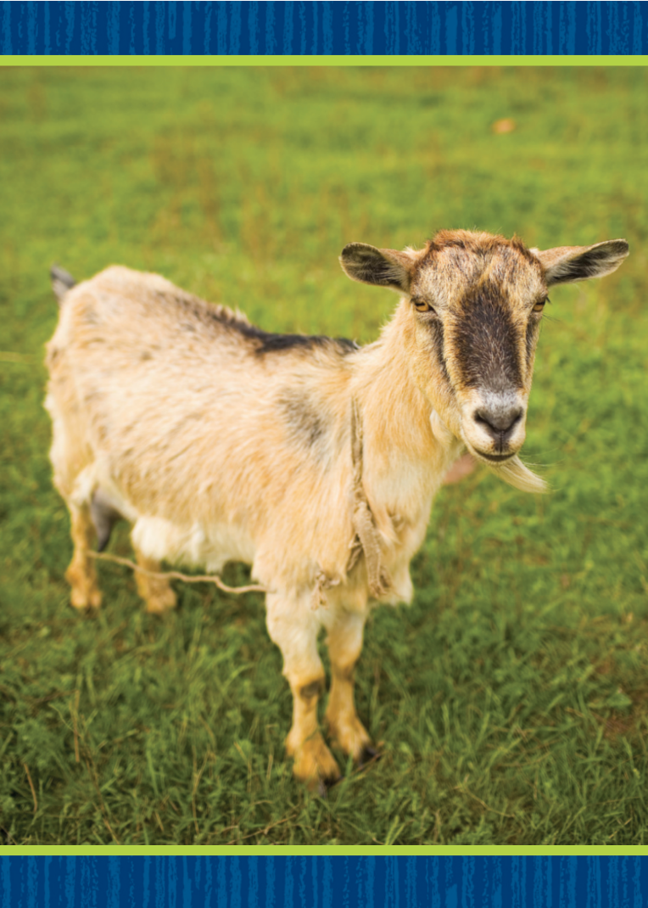
Phonological Awareness
Notes:
Display the goat Picture Card. This is a picture of a goat. Listen to the sounds in goat: /g/ /ō/ /t/. What sound do you hear in the middle of goat? Students should say /ō/. What sound do you hear at the end? Students should say /t/.
Then hold up the boat Picture Card. This is a picture of a boat. Boat rhymes with goat. When words rhyme, it means they have the same middle and ending sounds. Boat and goat have the sound /ō/ in the middle and the sound /t/ at the end.
Continue to display the Picture Cards for goat and boat. What other words can you think of that rhyme with goat and boat? Let's see how many we can name. Possible responses are moat, coat, float, and note. Click path -> Table of Contents -> Unit 2 Week 4 Informational Text -> Lesson 5

Slide 63
Phonics
Gg
br
pl
st
clap gap past
got gift gas
stop pig slam
Notes:
Write the letters Gg and the following examples of consonant blends on the board: br, pl, st. Have students identify the letters as you point to them. Then review the sounds for g and the consonant blends.
Create Team G and Team Blend. Have teams stand on opposite sides of the room. Then write the word clap on the board. We will use what we know about letters and sounds to decode this word together. If Team G hears the sound /g/, touch your nose. If Team Blend hears a blended sound, touch your nose. One word will have both the sound /g/ and a blend, so pay careful attention.
Point to each letter as you read the word. Let’s read this word together: /kl/ -ap, clap. Repeat with the words gap, past, got, gift, gas, stop, pig, and slam.

Slide 64
Page 140
Apply
Turn to page 140 in your Student Interactive and complete the activity.
Notes:
Have students turn to p. 140 in the Student Interactive and read and write the words with g and consonant blends

Slide 65
Page 141
Apply
Turn to page 141 in your Student Interactive and complete the activity.
Notes:
Have students turn to p. 141 in the Student Interactive. Have them read the sentences with a partner.

Slide 66
High-Frequency Words
four
five
here
Notes:
(Note: Move the orange boxes to cover each bold spelling word before you read aloud the words and sentences.)
Remind students that high frequency words are words that appear over and over in texts. Remind them they will be learning many of the words this year, and the words will help them become better readers.
Say the word four and ask students what letters spell the word. Have students
say the letters as you write them on the board.
say and spell the word, clapping their hands for each letter.
repeat with five and here.

Slide 67
Page 158
Reflect and Share
Turn to page 158 in your Student Interactive.
Notes:
Explain to students that when they read texts on a similar topic, it is important to talk about and describe opinions and personal connections to the texts to make sure they and their classmates understand the same things about the topic. They can use an oral, pictorial, or written response to demonstrate understanding.
Tell students that after they read, they should
think about the main topic of each text.
be able to summarize the main ideas to another person.
listen to the ideas of others in order to connect ideas across the texts.
Ask students to turn to p. 128 in the Student Interactive. Reread the text for students. Continue with the text starting on p. 158. These texts are about animals and how they eat. That makes me think about what my favorite animal I read about is. I really liked reading about the bear because I got to see its huge teeth in the picture. I also learned what it ate. Which animal do you like best?
Provide additional examples of oral responses that students may have after reading the texts. Then have students recall what they learned in the texts and describe how what they learned connects to their own lives.

Slide 68
Page 158
Apply
How do different animals eat their food?
Notes:
Have students use the strategies for sharing information and ideas across texts.
Have students respond orally to complete the activity on p. 158 in the Student Interactive

Slide 69
Page 165
Writing – List Book
Turn to page 165 in your Student Interactive.
Notes:
Adjectives are used to describe size, color, or shape. An author uses adjectives to help a reader make a picture in his or her mind.
Prior to the lesson, have enough adjectives written on flashcards for everyone in the class to have one, plus a few extras. The adjectives can be limited to size, color, and shape. Give one flashcard to each student. Then write sentences on the board, such as:
I spilled paint on my shirt.
The elephant played with a toy.
I will put this book on the shelf.
This sign is perfect for my clubhouse.
Alternately, write sentences from a stack book but remove the adjectives. These sentences don’t have any describing words. Let’s revise these sentences by adding adjectives to make them more interesting. Raise your hand if you have a word that will describe a noun in this sentence.
Read the sentences one at a time and have student volunteers suggest adjectives, providing assistance as necessary. Write the adjectives on the board, and then read the sentences again. When we edit these sentences to include adjectives, they are so much more interesting! When you write your list books, make sure you include adjectives.
Have students turn to p. 165 of the Student Interactive. Read the page together and assist students in completing the activity, as needed.
Ask for student volunteers to share their list books and drawings. Tell the class to discuss an adjective and how it was used to describe size, color, or shape.

Slide 70
Language and Conventions
The class laughed at their favorite joke.
Which word is a verb that shows an action that happened in the past?
class
laughed
favorite
joke
Notes:
Display the following sentence and guide students to complete the question.
(1) The class laughed at their favorite joke.
Which word is a verb that shows an action that happened in the past?
A class
B laughed
C favorite
D joke
Have students complete Language and Conventions, p. 89, from the Resource Download Center. Click path: Table of Contents -> Resource Download Center -> Language and Conventions -> U2 W4

Slide 71
Unit 2: Week 4
Grade K

